Slide 1
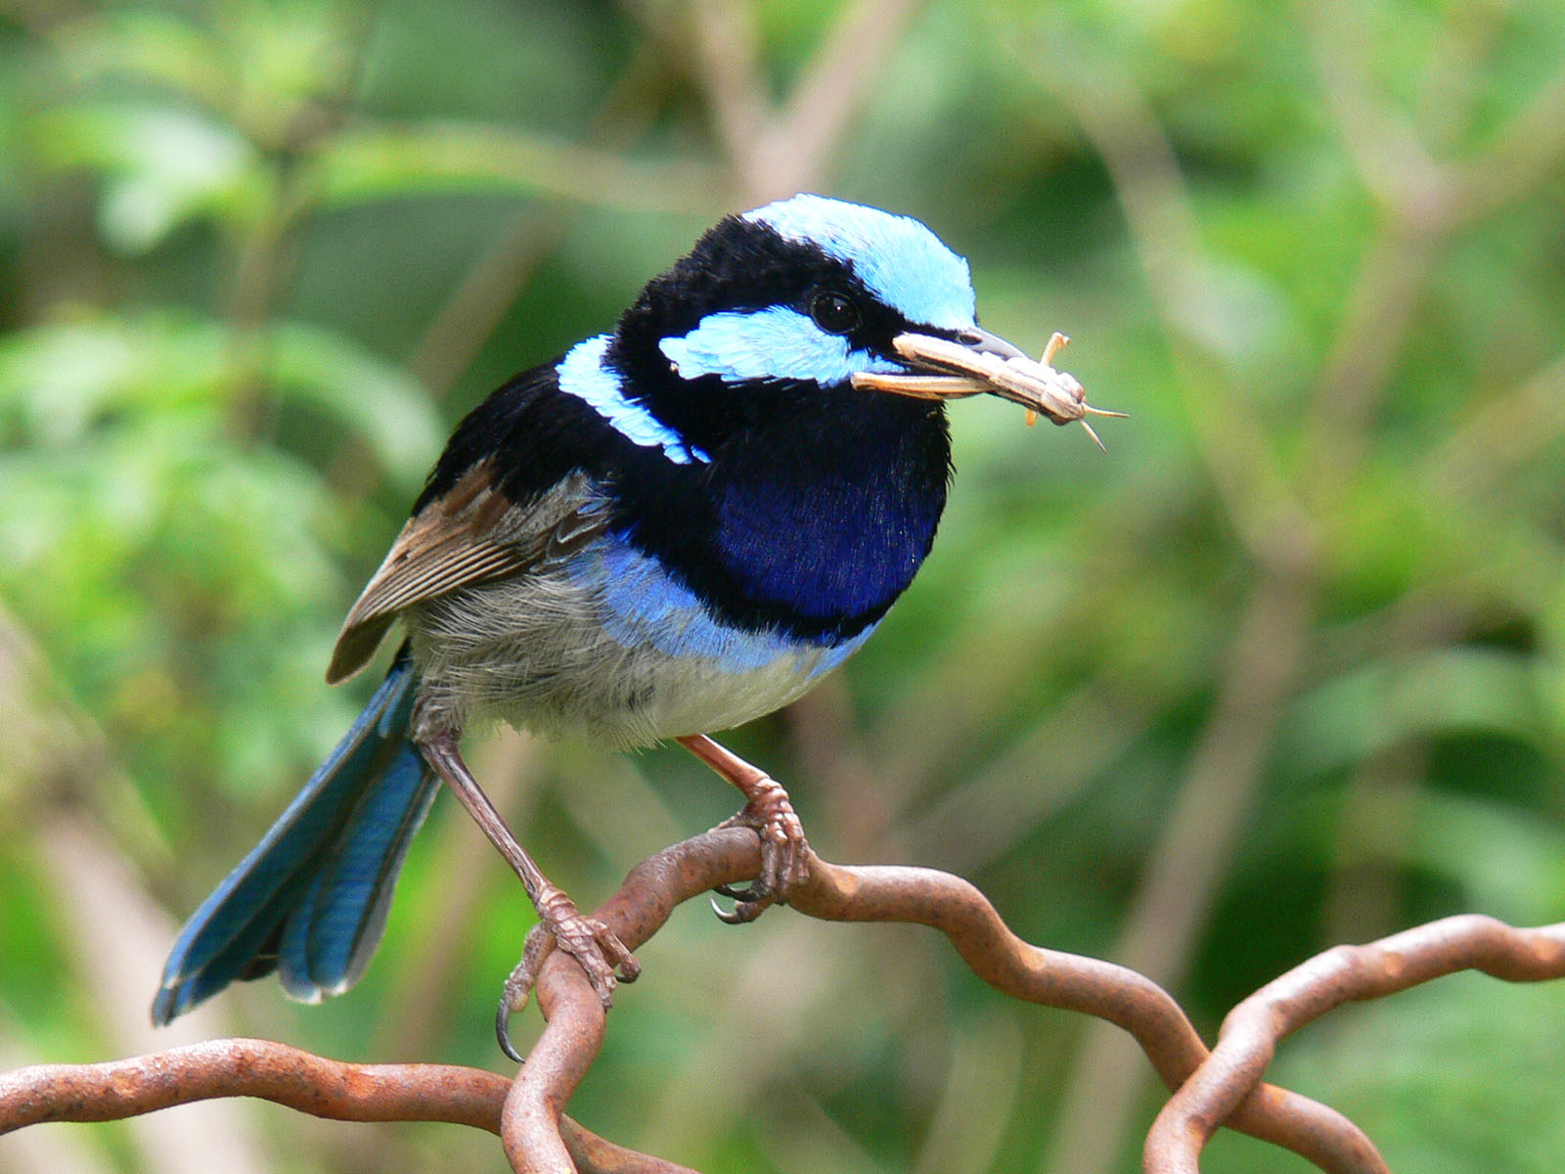
Stem Club Research Journal
This Photo by Unknown Author is licensed under CC BY-SA
Student Name ___________________________

Slide 2
1. REVIEW THE WEBSITES AND READ ABOUT AT LEAST 3 BIRDS NATIVE TO MICHIGAN BEFORE BEGINNING YOUR RESEARCH
Choose 1 bird to complete the rest of the assignment. answer the following questions before beginning to design your bird house
What is the name of the bird you are researching?
What parts of Michigan does it primarily live?
What time of year does it live in Michigan?
Does it migrate?
Where does it migrate to?

Slide 3
Describe the type of next it makes.
DESCRIBE SOME PROBLEMS THAT THIS SPECIES OF BIRDS ENCOUNTERS.

Slide 4
WHAT TYPE OF HUMAN INTERACTION DOES IT HAVE?
Have humans created problems for this species?
What can humans do to help this species?

Slide 5
Use this page to add any additional information that may help people understand this bird.

